Slide 1
UNIT TESTING

Slide 2
AGENDA
Unit test
Jasmine
Karma
ngMock
Chrome / Phantom JS

Slide 3
UNIT TEST
Unit test is a piece of code which tests the behaviour of function or class.
Unit tests are written by the developers.
Unit testing helps you really understand the code you are really working on. Instead of writing code to do something, you are starting by outlining all the conditions you are subjecting the code to and what output you’d expect from that.

Slide 4
Jasmine
Jasmine is a Behaviour Driven Development testing framework for Javascript.
It doesn’t rely on browser , DOM and any other Javascript Framework.
Thus it is suited for Websites, NodeJS Projects,are anywere that Javascript can run.
https://jasmine.github.io/2.0/introduction.html

Slide 5
SAMPLE TEST CODE for JS
npm install
npm install jasmine-core --save-dev

Slide 6
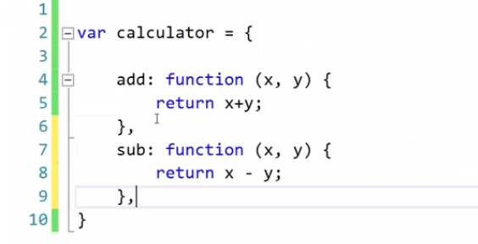
cal.js

Slide 7
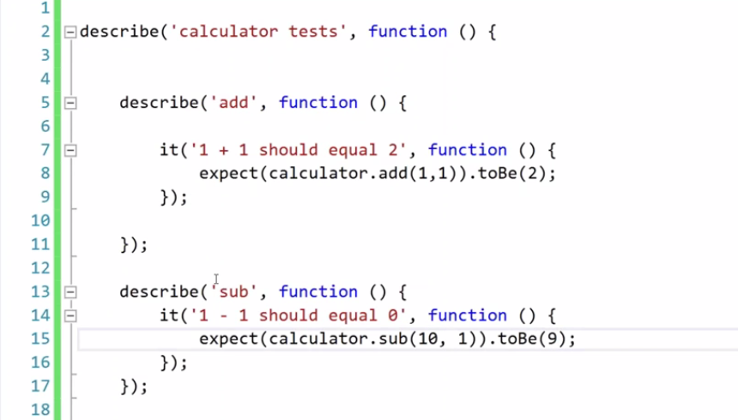
caltests.js

Slide 8
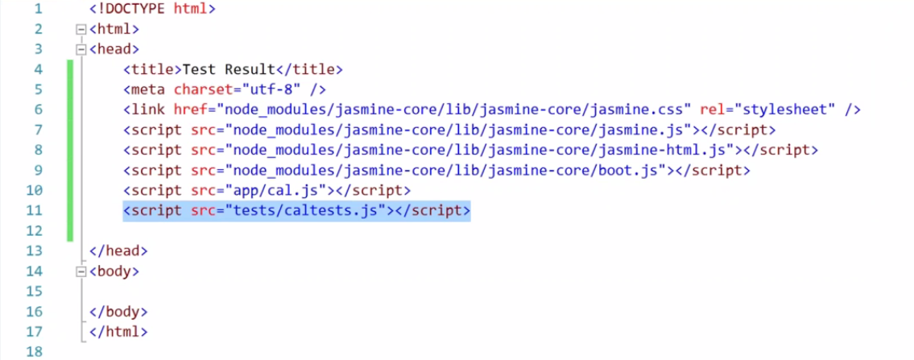
Specrunner.html

Slide 9
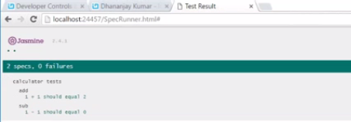
Execute specrunner.html

Slide 10
Karma
Karma is test runner created by the Angular js team.
Karma provides helpful tools that make it easier to us to call our jasmine tests while we are writing code.
It is Javascript command line tool that can be used in webserver which loads the application source code and executes your tests.
It can be configured to run against various browsers .
It is executed on the command line and will display the results of your tests on the command line once they run in the browser.
It is a node js application, and should be installed through npm
https://karma-runner.github.io/0.13/index.html

Slide 11
ngMock
ngMock provides support to inject and mock Angular services into unit tests.
The ngMock also extends various core ng services such that they can be inspected and controlled in a synchronous manner with in test code.
The ngMock module is in the namespace angular.mock
https://docs.angularjs.org/api/ngMock

Slide 12
Unit Test Installation
1) npm and npm-chatch folders are delete from your Roaming directory (C:\Users\dhandr2\AppData\Roaming)
2) node-modules and typings folders are delete from your project directory (C:\Users\dhandr2\DVP\22Mar2017\DataViz-UI)
3) Install node-v6.9.5-x64
4) Install Below things in Step by Step
npm install -g
npm install -g npm@3
npm install -g angular-animate@1.5.8
npm install -g angular-aria@1.5.8
npm install -g gulp@3.9.1
npm install -g jasmine-core@2.5.2
npm install -g webpack@1.13.0 --save-dev
npm install -g karma@0.13.22
npm install -g karma-jasmine@1.0.2
npm install -g karma-webpack@1.7.0 --save-dev
npm install -g karma-chrome-launcher@0.2.3 --save-dev
npm install -g karma-phantomjs-launcher@1.0.2 --save-dev
npm install -g karma-coverage@1.0.0 --save-dev
npm install -g karma-spec-reporter@0.0.26 --save-dev
npm install -g tsd
tsd install
npm install
5) Take latest code from Git : package.json , karma.conf.js and .gitignore
6) Karma start (or) gulp test
npm ls -g --depth=0

Slide 13
Thank You

